Slide 1
Moai by Peopoly
Kit Installation Guide

Slide 2
Frames
Instruction starts next page.
You can use Video Tutorial Part3 to help

Slide 3
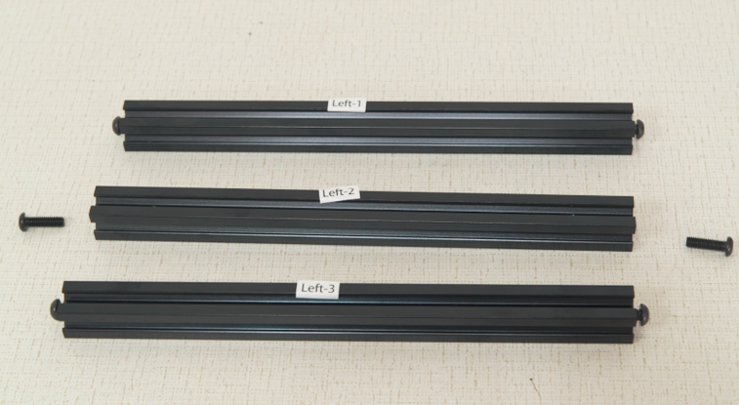
Please find these 3 bars
They are labeled:
“Left1”
“Left2”
“Left3”

Slide 4
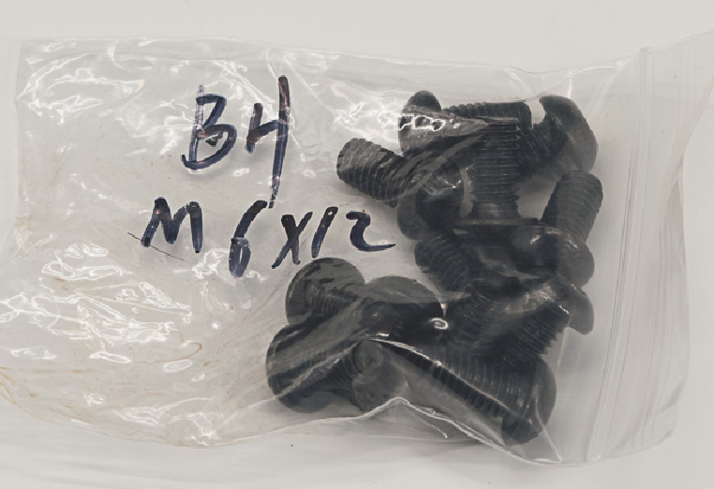
Please get 4 screws from the bag labeled “BH M6x12”
And screw two per bar half way on “Left1” and “Left3”
Screw them in until there is 3 to 5mm remaining out
This will make it easier to align with the slots in the frame in later steps.

Slide 5
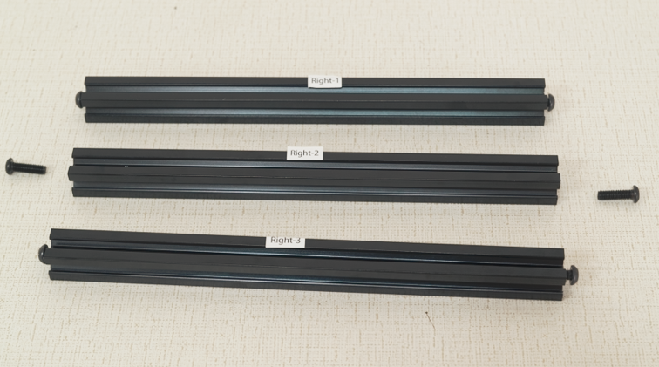
Please find these 3 bars
They are labeled:
“Right1”
“Right2”
“Right3”

Slide 6
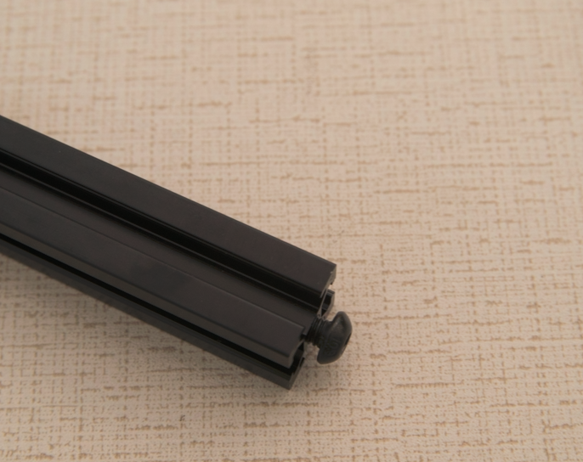
Please get 4 screws from the bag labeled “BH M6x12”
And screw two per bar half way on “Right1” and “Right3”
Screw them in until there is 3 to 5mm remaining out
This will make it easier to align with the slots in the frame in later steps.

Slide 7
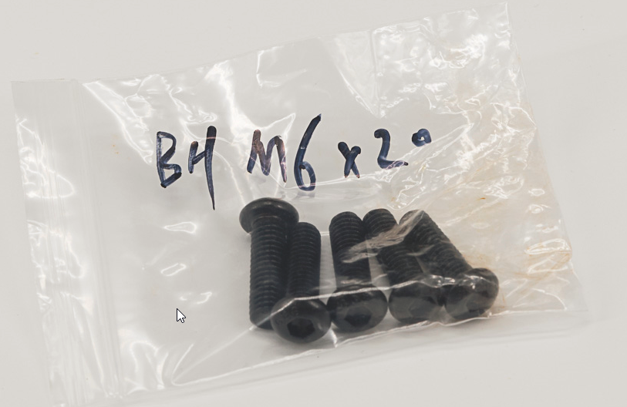
Please get 4 screws from the bag labeled “BH M6x20 “
These are for Left2 and Right2 bars. 2 Each bar. Use it later
Screw them in until there is 3 to 5mm remaining out
This will make it easier to align with the slots in the frame in later steps.

Slide 8
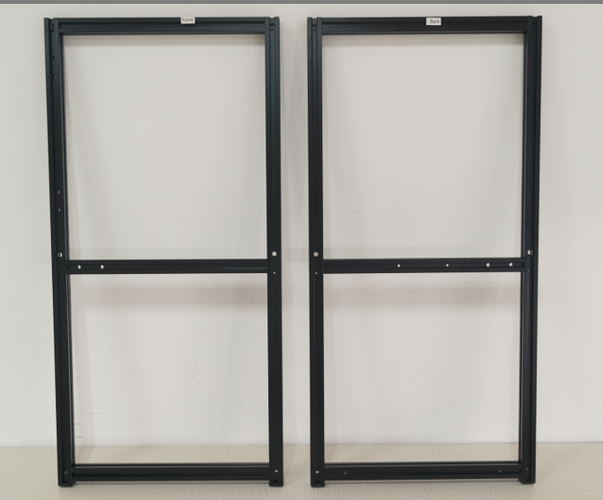
Please find assembled front and back frame labled Front and Back
The front frame has labels start with Front
The back frame has labels start with Back
The side of each frame that is facing outward is where the sticker is located

Slide 9
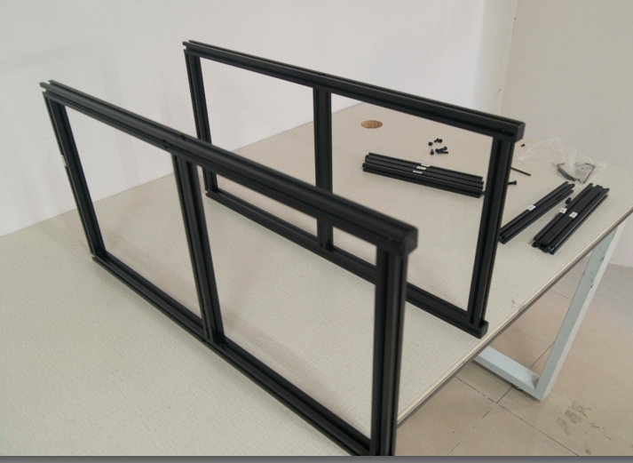
Put Front and Back Frame in parallel on the table
Put Front on the left hand side, sticker facing left. Rubber feet facing you
Put Back Frame on the right. Sticker facing right. Rubber feet Facing you.
Where Sticker is facing is important. The stickers for the front and the back should be facing away from each other

Slide 10
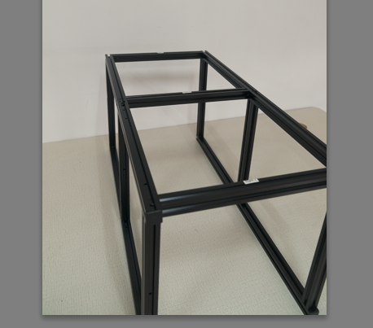
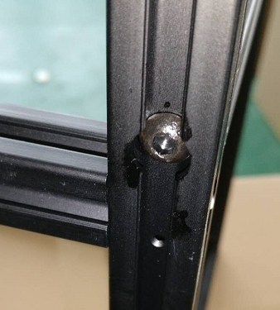
Install Right1, Right2, Right3 bar between Front and Back frame
First Install Right3, put the screw between extrusion and slide all the way down toward to rubber feet.
Then Install Right2, Use the previous found BH M6-20 to secure it in the middle by locking from outside
Finally Install Right1
Sticker side of bar should face outward
Do not overtighten - you may need to adjust things slightly in later steps.

Slide 11
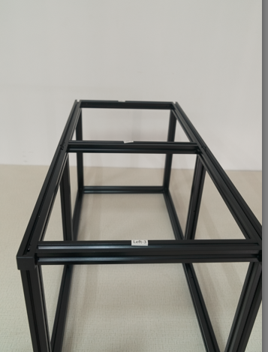
Install Left1, Left2, Left3 bar between Front and Back frame
Flip the frames over
First Install Left3, put the screw between extrusion and slide all the way down toward to rubber feet.
Then Install Left2, Use the previous found BH M6-20 to secure it in the middle
Finally Install Left1
Sticker side of bar should face outward
Do not overtighten - you may need to adjust things slightly in later steps.

Slide 12
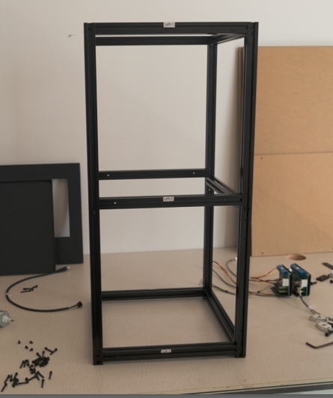
The frame should look like this when it is done correctly
Stickers from all 4 sides should facing outward, like the picture shown
If you have problem, you can use this video as guideline

Slide 13
Z-Axis - Platform
Instruction starts next page.
You can use Video Tutorial Part 4 to help

Slide 14
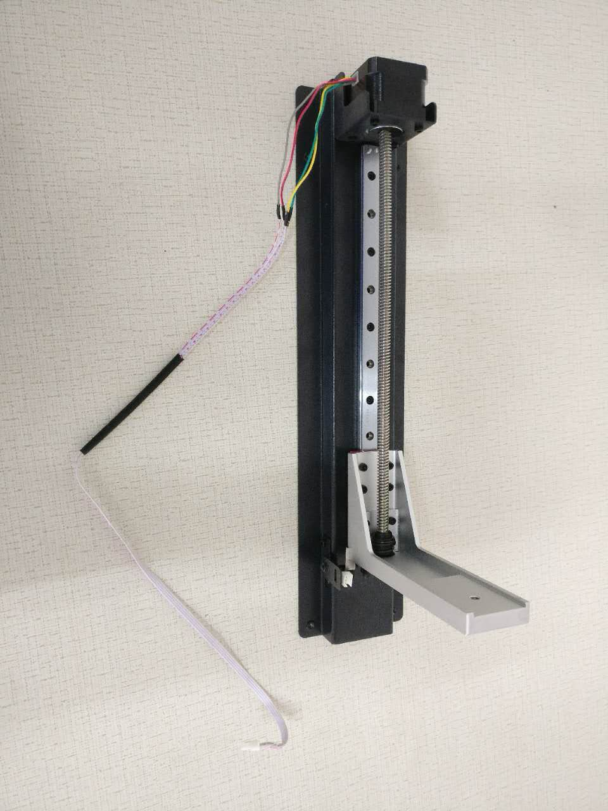
Find the assembled Z-Axis in the box that looks like this
video tutorial part 4

Slide 15
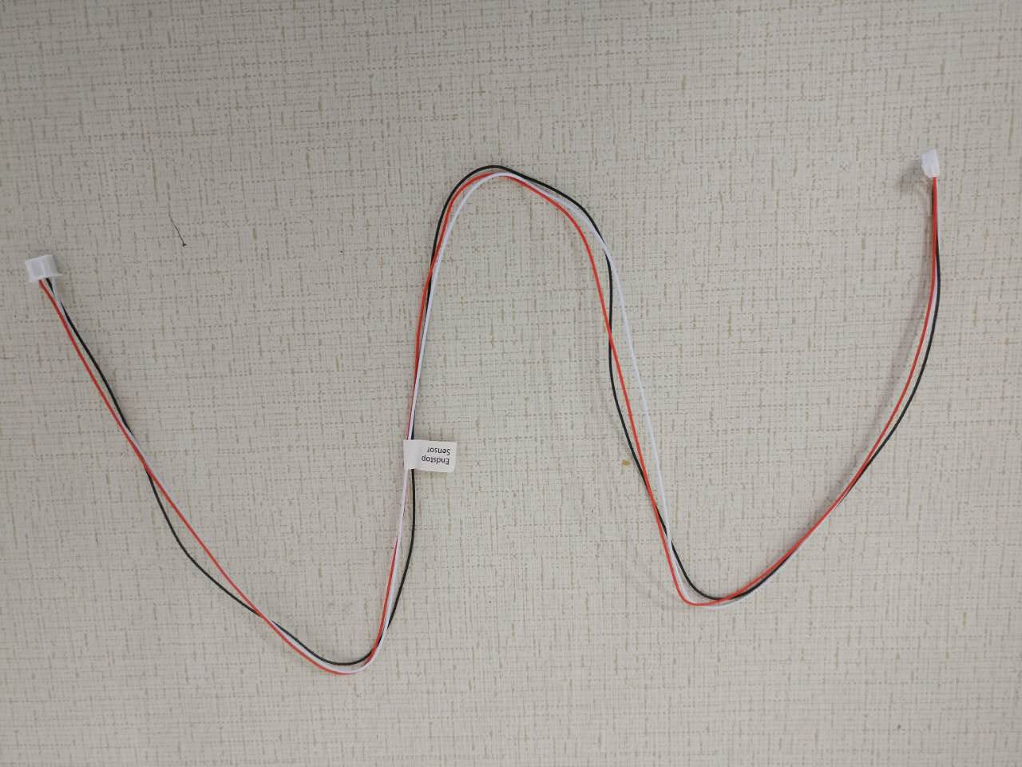
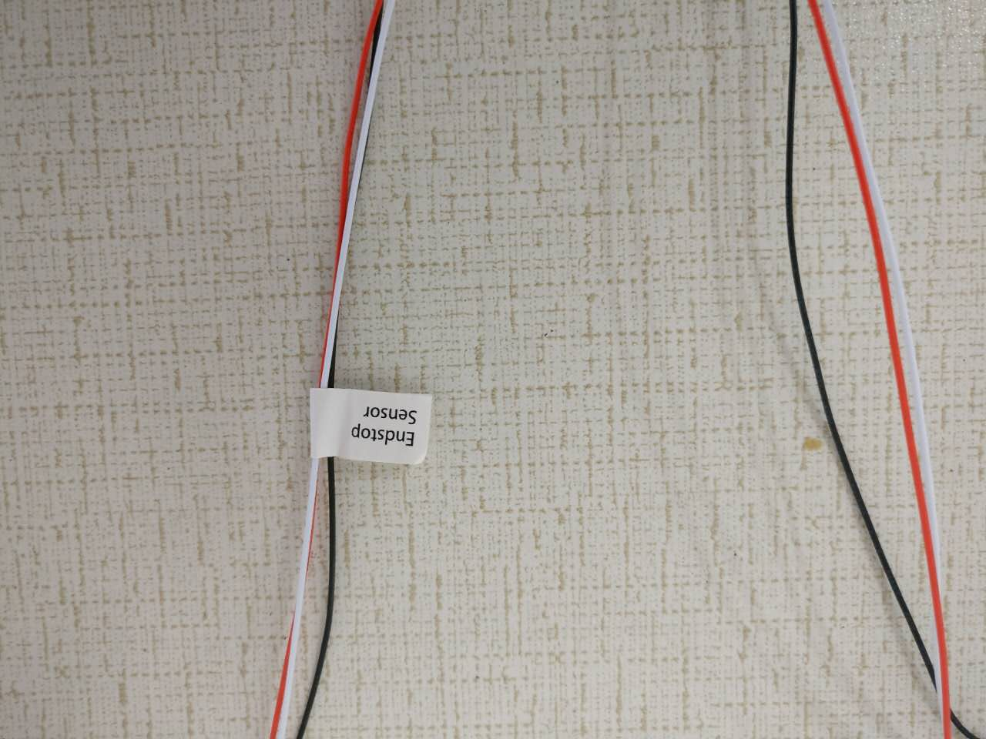
Find the Endstop Sensor cable that looks like this
video tutorial part 4

Slide 16
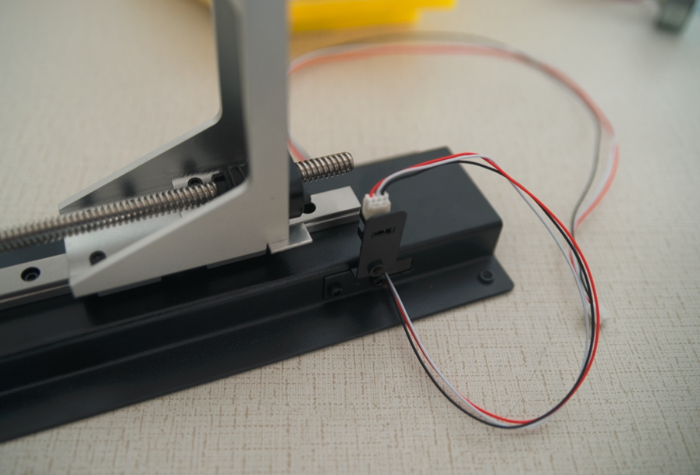
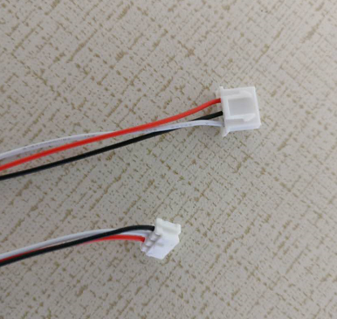
Connect Endstop Sensor cable to Z-axis as following
video tutorial part 4
The smaller connector on the endstop sensor cable goes into the socket on the Z-axis.
Ensure connection is secure as this is needed to stop Z-axis motor from over extending the build plate arm

Slide 17
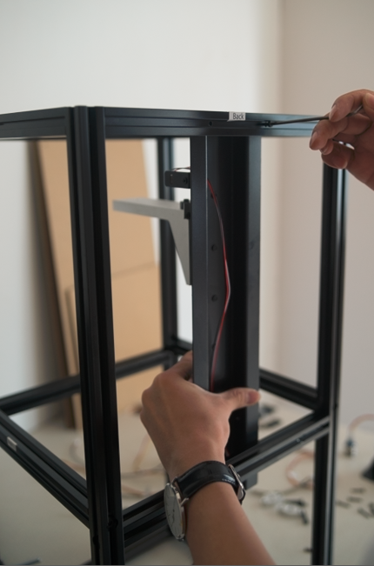
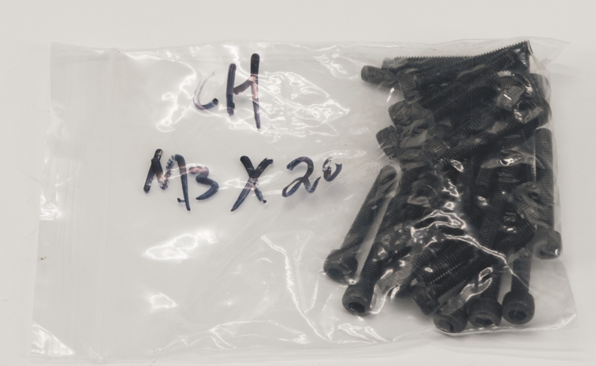
Find 4 CH M3-20 screws and use it to Mount Z-Axis to Back frame
video tutorial part 4
The bolt head goes on the outside of the frame and screws into the built-in threads
on the Z-axis.

Slide 18
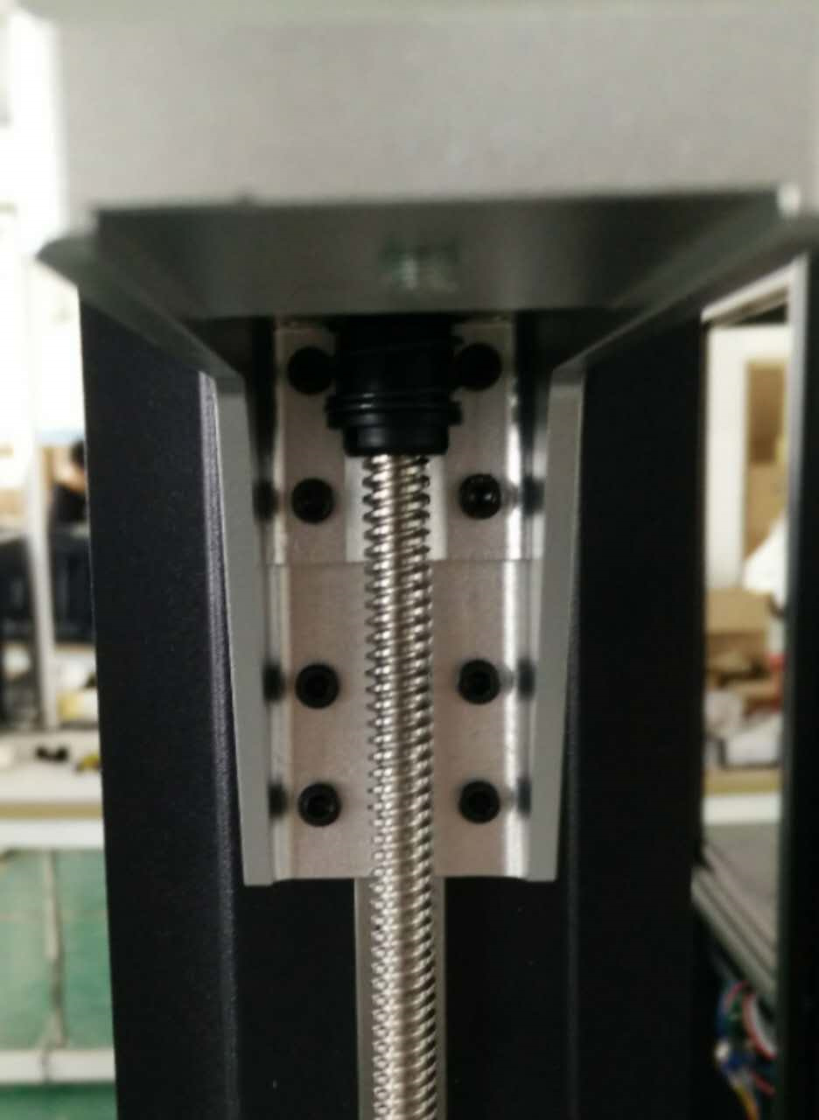
When installing, we now recommend checking to see these eight screws locking the build plate arm are secured. The screws may have become loose during shipment:

Slide 19
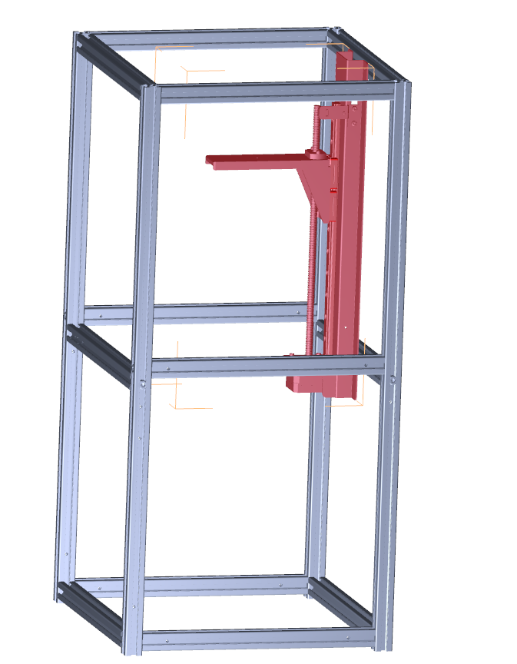
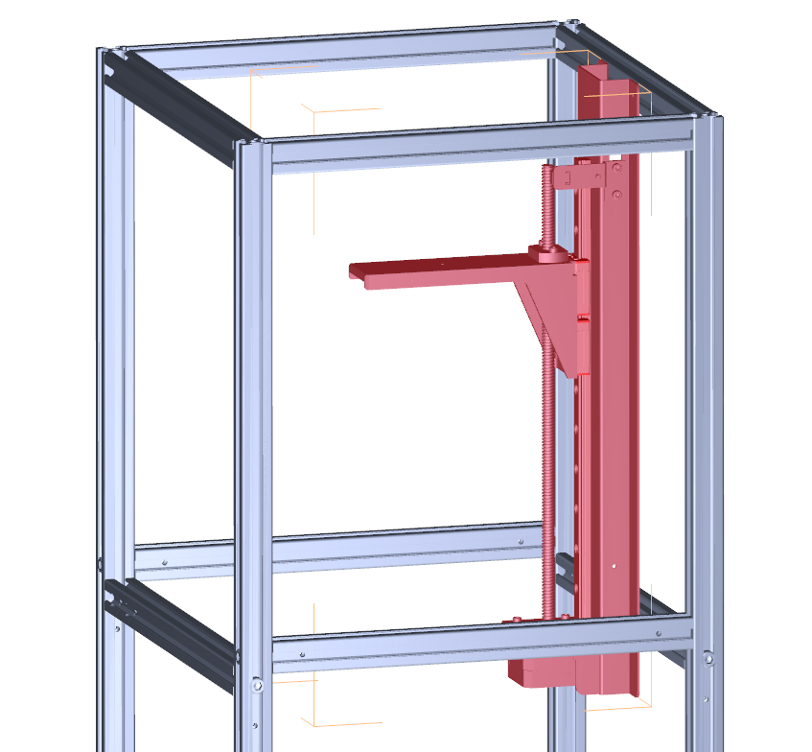
With Z-axis and rails installed, Moai should look like this now
Front

Slide 20
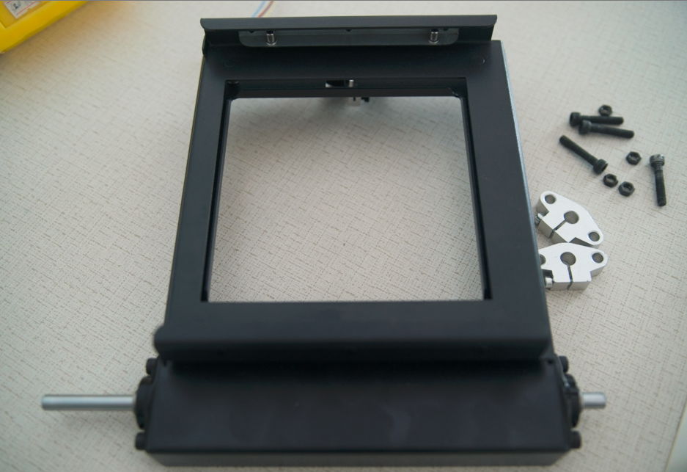
Once the Z-Axis is secured, find the Platform, it comes assembled
video tutorial part 4

Slide 21
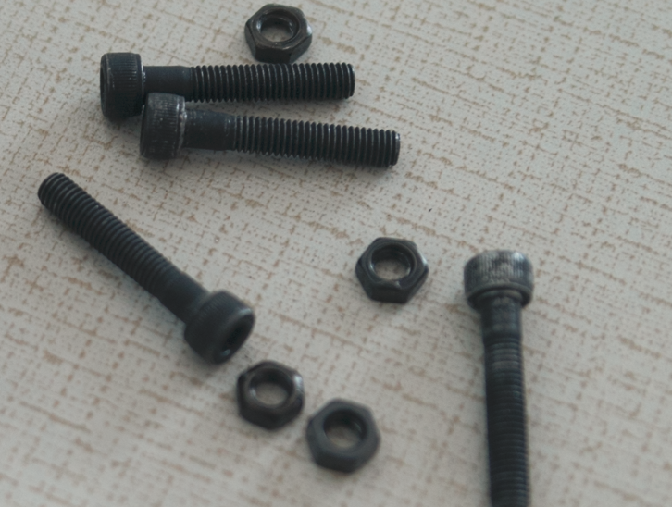
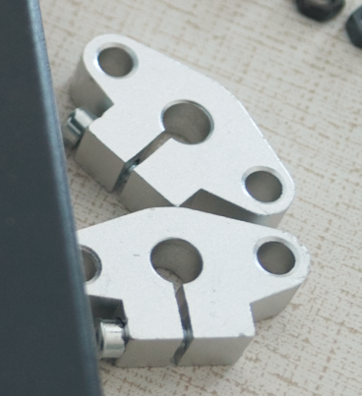
Find 4 CH M5-27 screws and nut. two Silver colored bracket

Slide 22
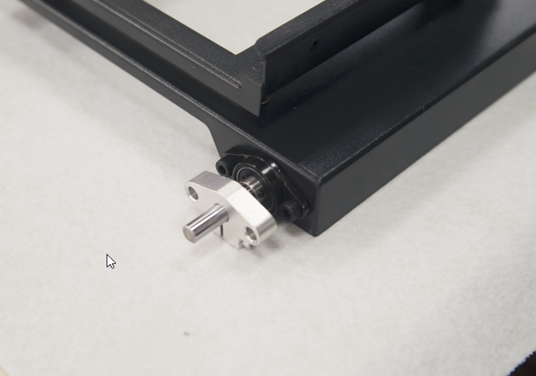
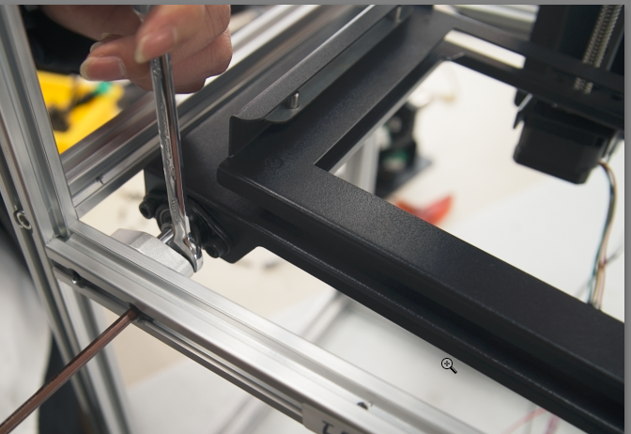
Put the Silver Bracket on the Platform’s metal rod.
Install the Platform cross from Front and Back frame with the beam is close to the Left Frame Use CH M5-27 screws to secure. Should install both Silver Brackets first before tightening. Silver Brackets as it touch both Front and Back frame. Keep the rod somewhat loose as you need to make adjustment later video tutorial part 4

Slide 23
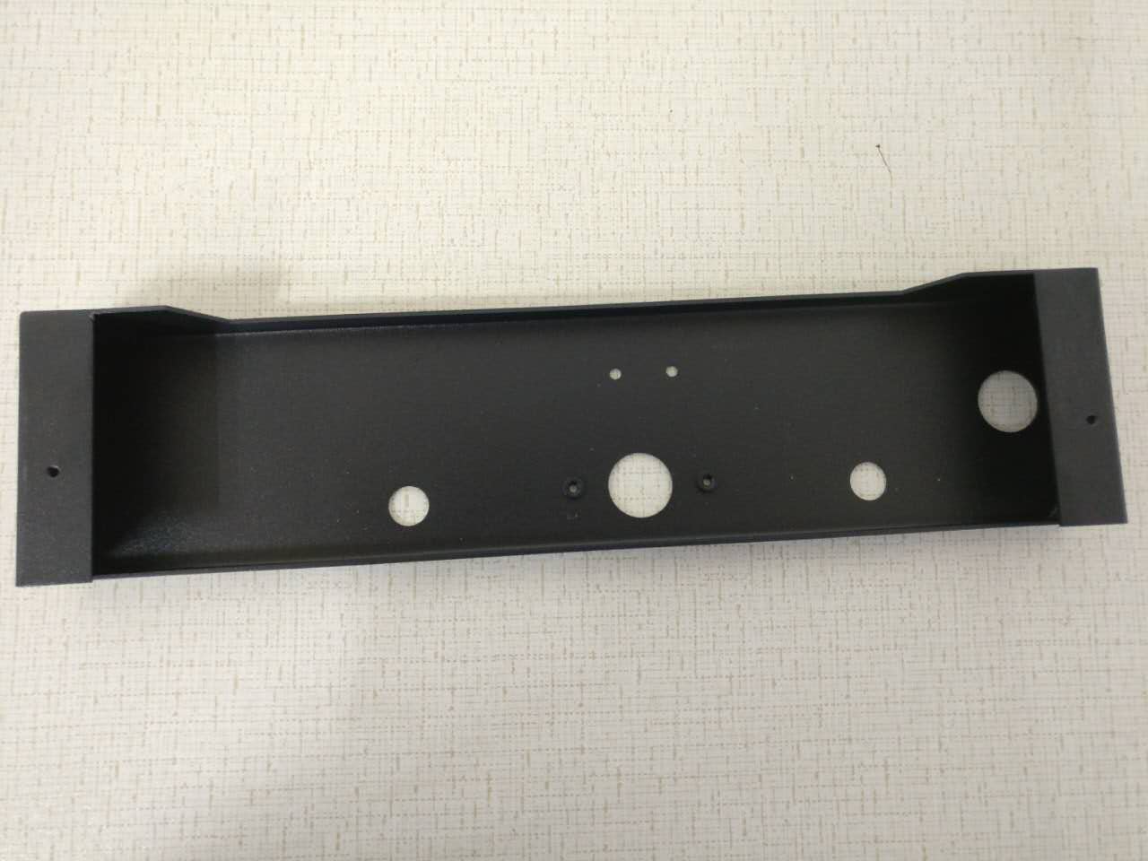
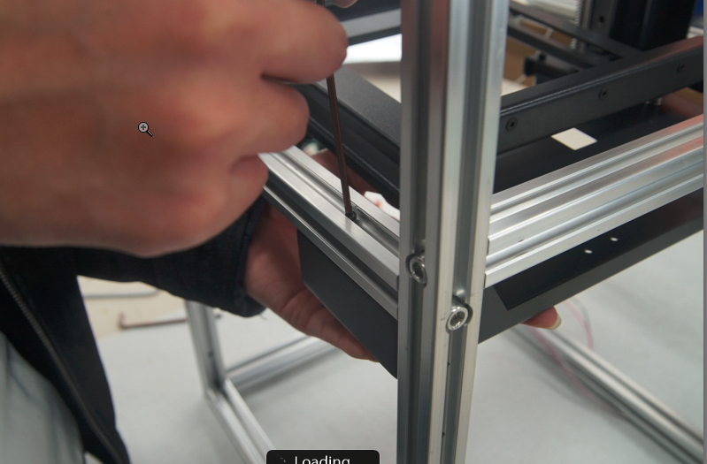
Find the below metal piece in the lower right piece secure it with between Front and Back frame near Right side. 4 CH M3-20 screws
This is easiest if you insert the top 2 screws first, then the back 2 should go in easily.
video tutorial part 4
Right Frame
Front Frame
Right Frame

Slide 24
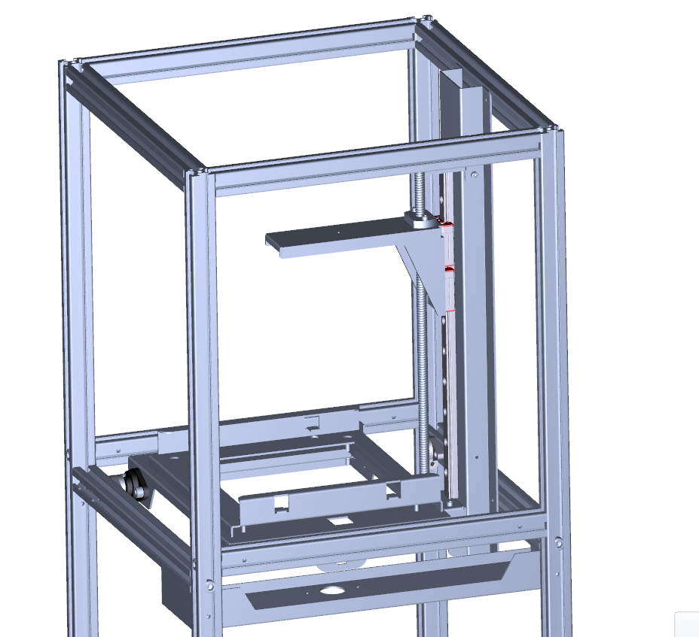
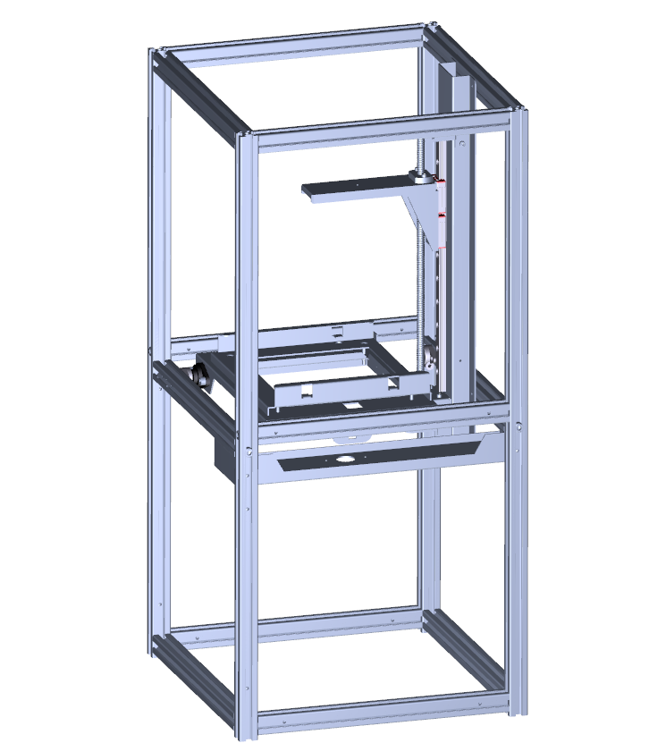
Moai should look like this at this point

Slide 25
Riser Motors and Panels
Instruction starts next page.
You can use Video Tutorial Part5 to help

Slide 26
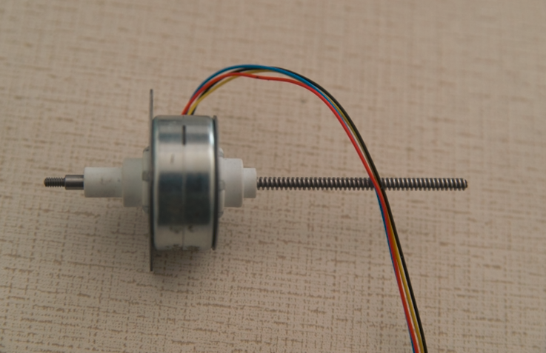
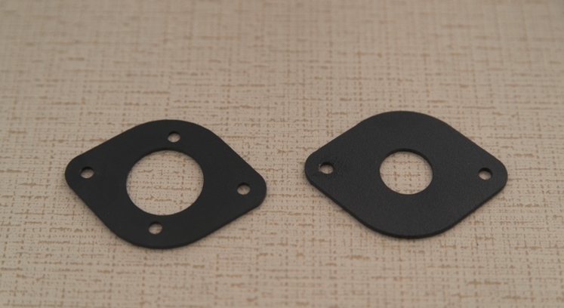
Find the Rise Motor and the two Brackets
Video Tutorial part 5

Slide 27
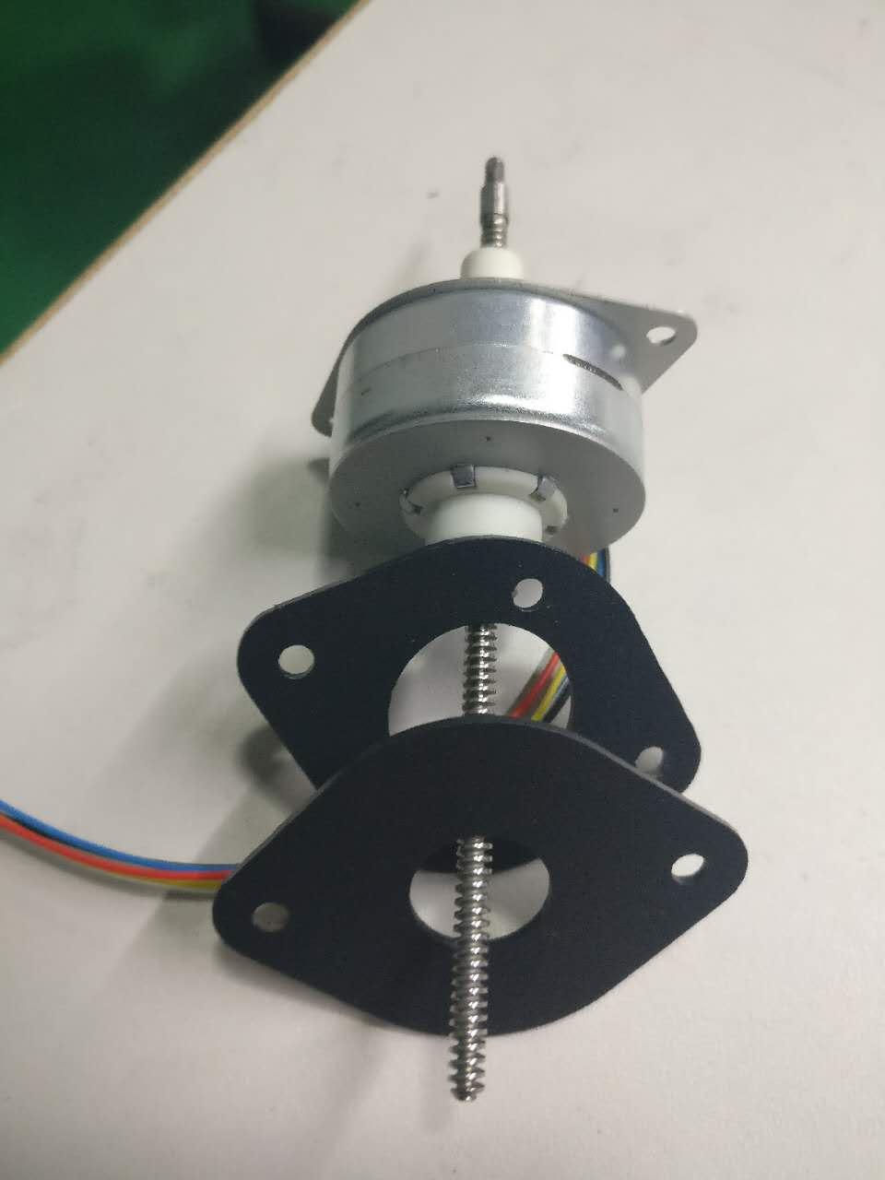
Install Brackets on Rise Motor like this
Video Tutorial part 5
The bracket with larger center hole goes in first.

Slide 28
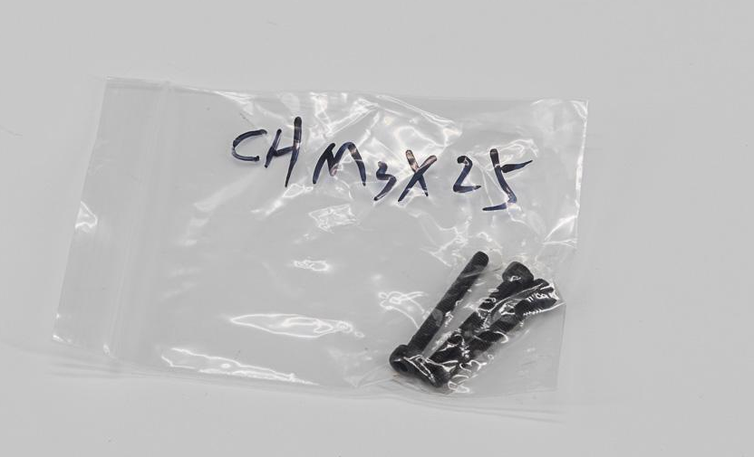
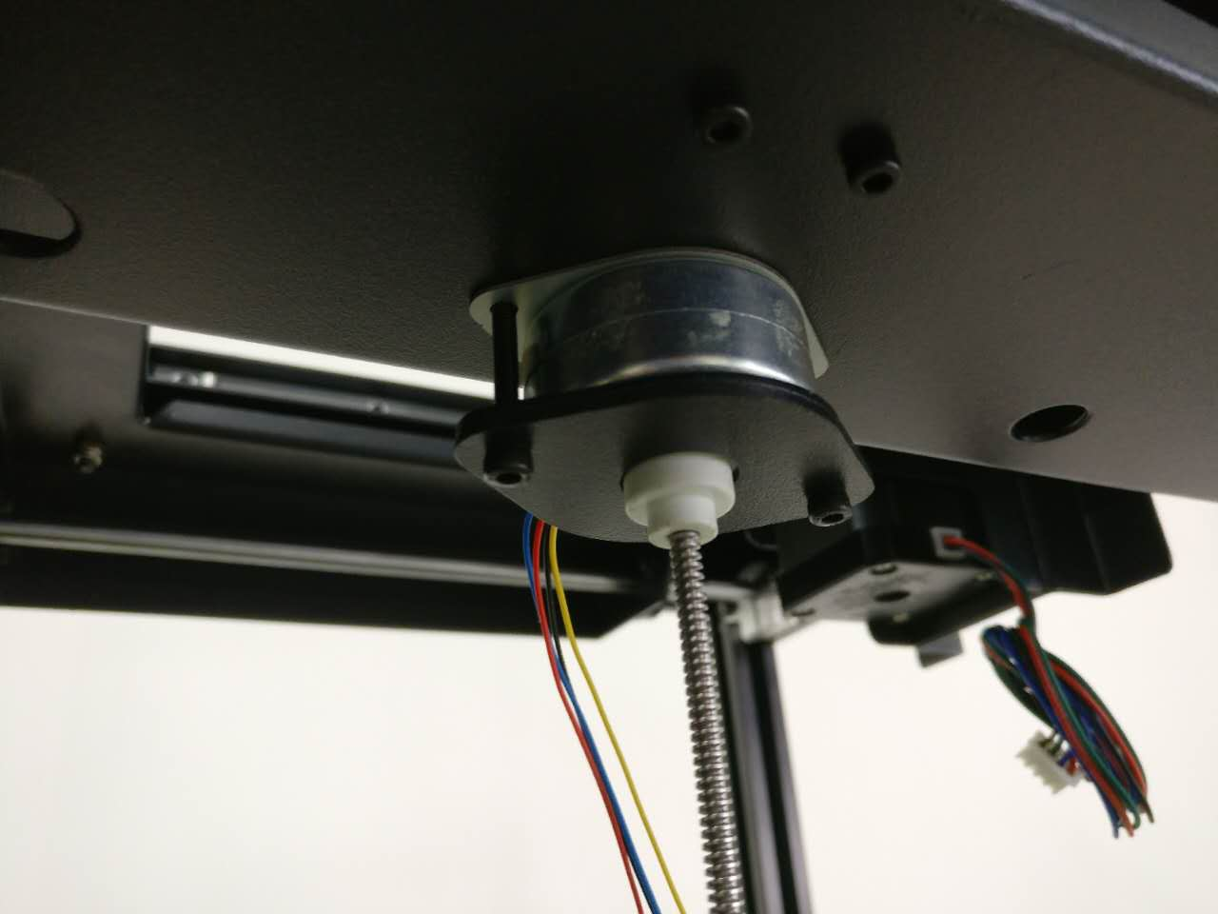
Secure Rise Motor with CH M3-25 from the bottom near Right frame
Video Tutorial part 5

Slide 29
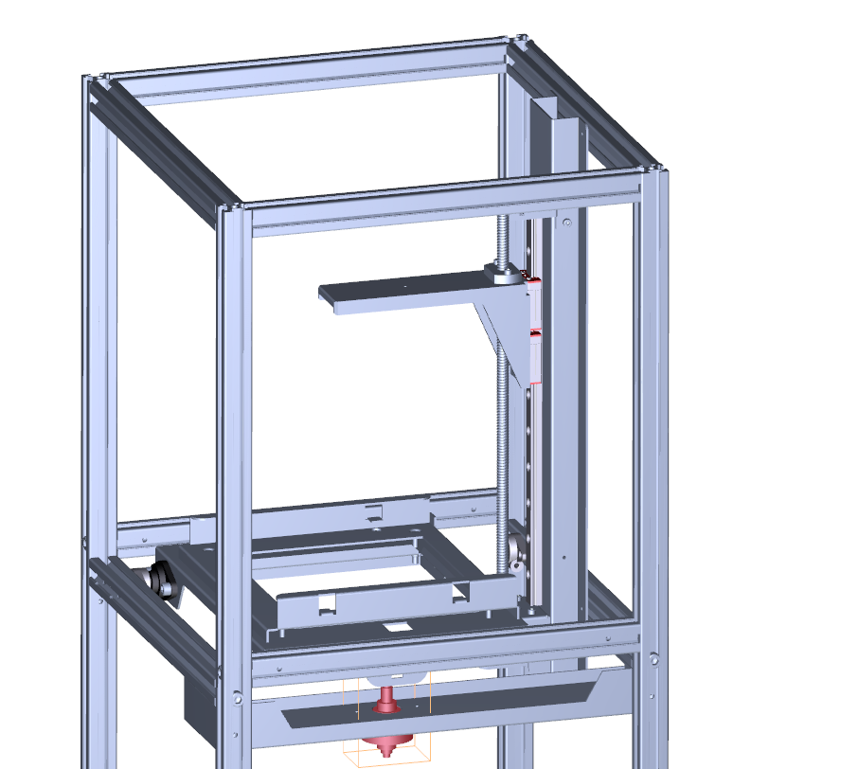
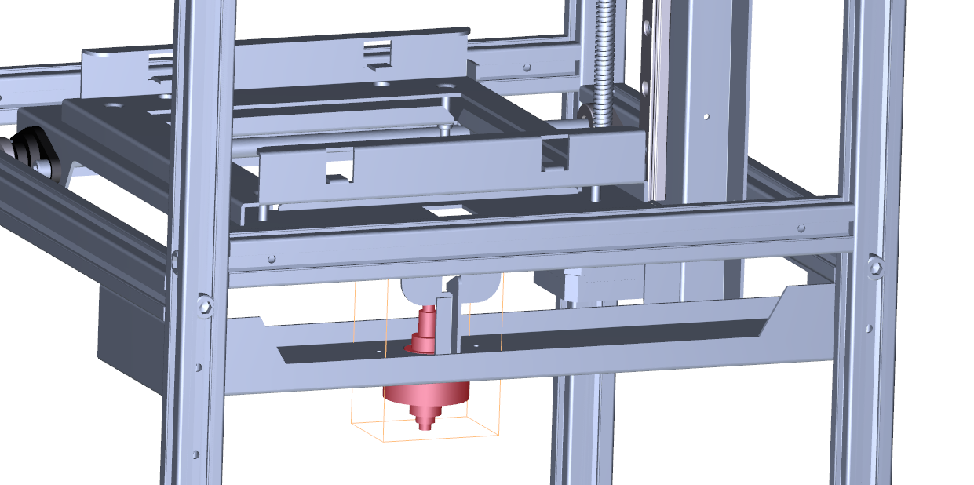
Here is the location of Rise Motor with respect to Moai

Slide 30
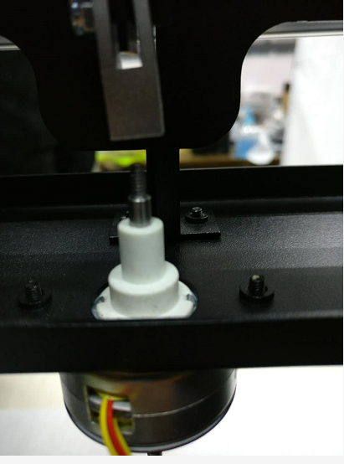
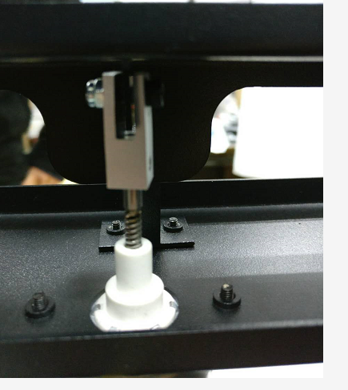
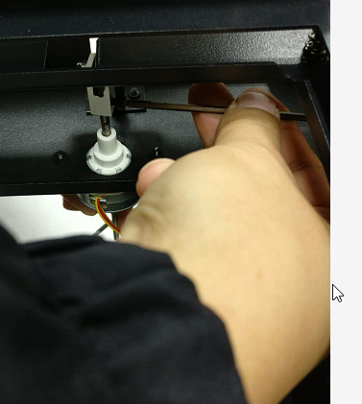
Use hand to turn the long threaded beam on Riser Motor upward, such that it screws into the tiny Silver Metal Part. (move the platform a bit if needed) Move the beam up to a point where the unthreaded metal cylinder touches Silver Metal Part. The use the CH M3-4 or CH M3-5 to tighten it. No need to over secure it. Make sure the Silver Metal Part is straight with the Riser Motor’s beam
Video Tutorial part 5

Slide 31
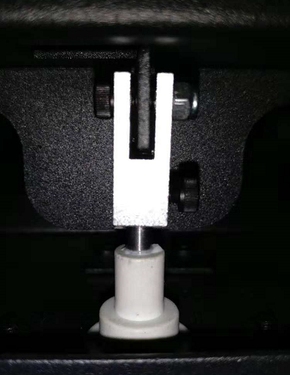
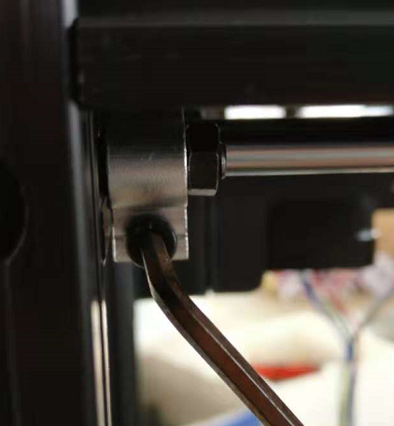
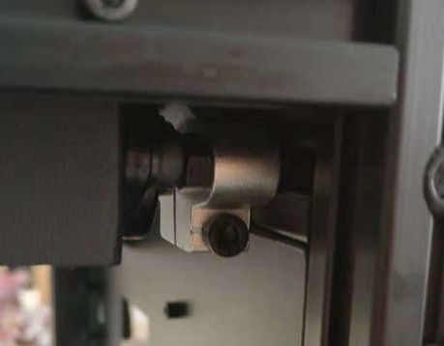
A frequent installation mistake in this part is that the metal is not in the center of the Silver Metal Part and it would rub against each other during move. You can center the black metal piece by moving the Platform via loosening the screws on the Silver colored brackets on each end of the metal bar

Slide 32
After you are able to install and align Riser Motor to the platform, it is time to secure the metal rods so it does not wiggle at all. Secure and tighten all screws pointed out by arrows in below pictures. There are 3 on each Silver Bracket
Follo video here if you have issues.
*This is a common area where use forgotten to tighten and it affects printing later on.

Slide 33
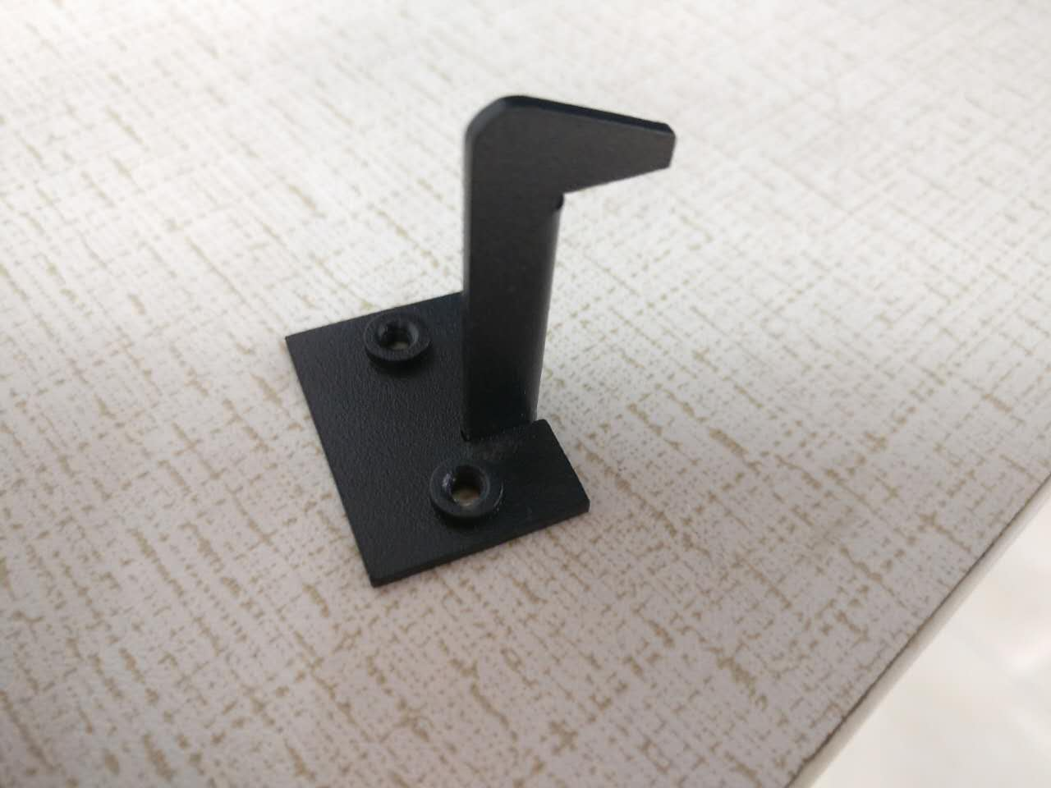
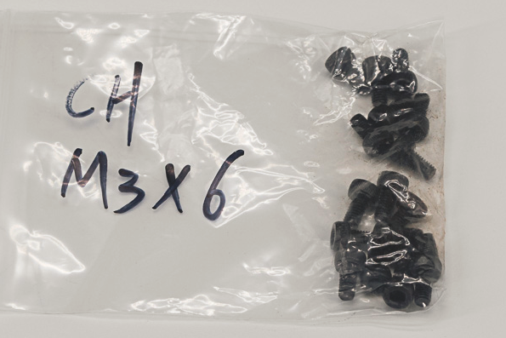
Find this Metal Piece with Hook. And 2 CH M3-6 screws
Video Tutorial part 5

Slide 34
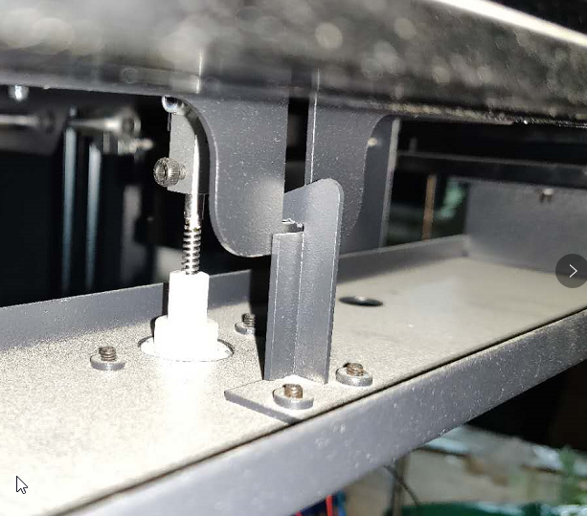
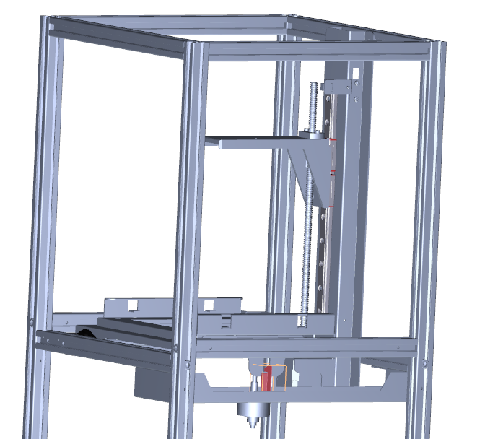
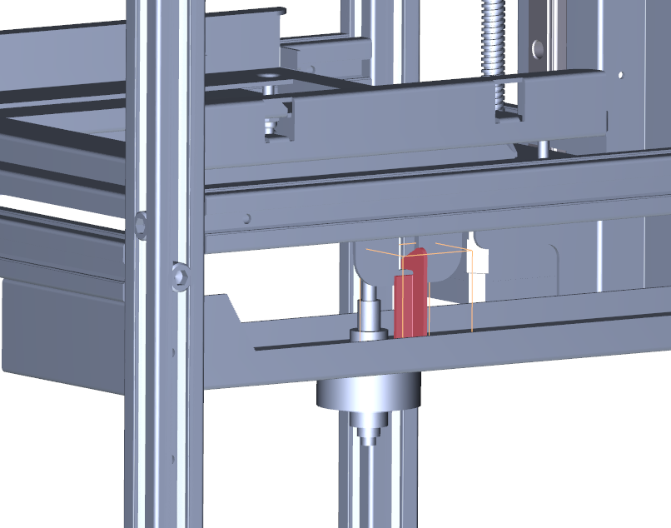
Here is the location of Metal Piece with Hook with respect to Moai

Slide 35
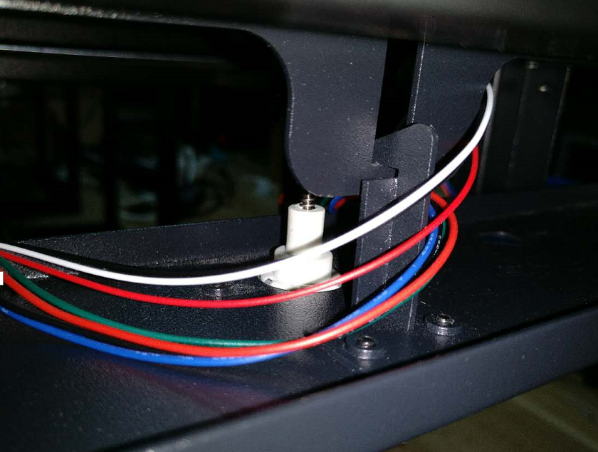
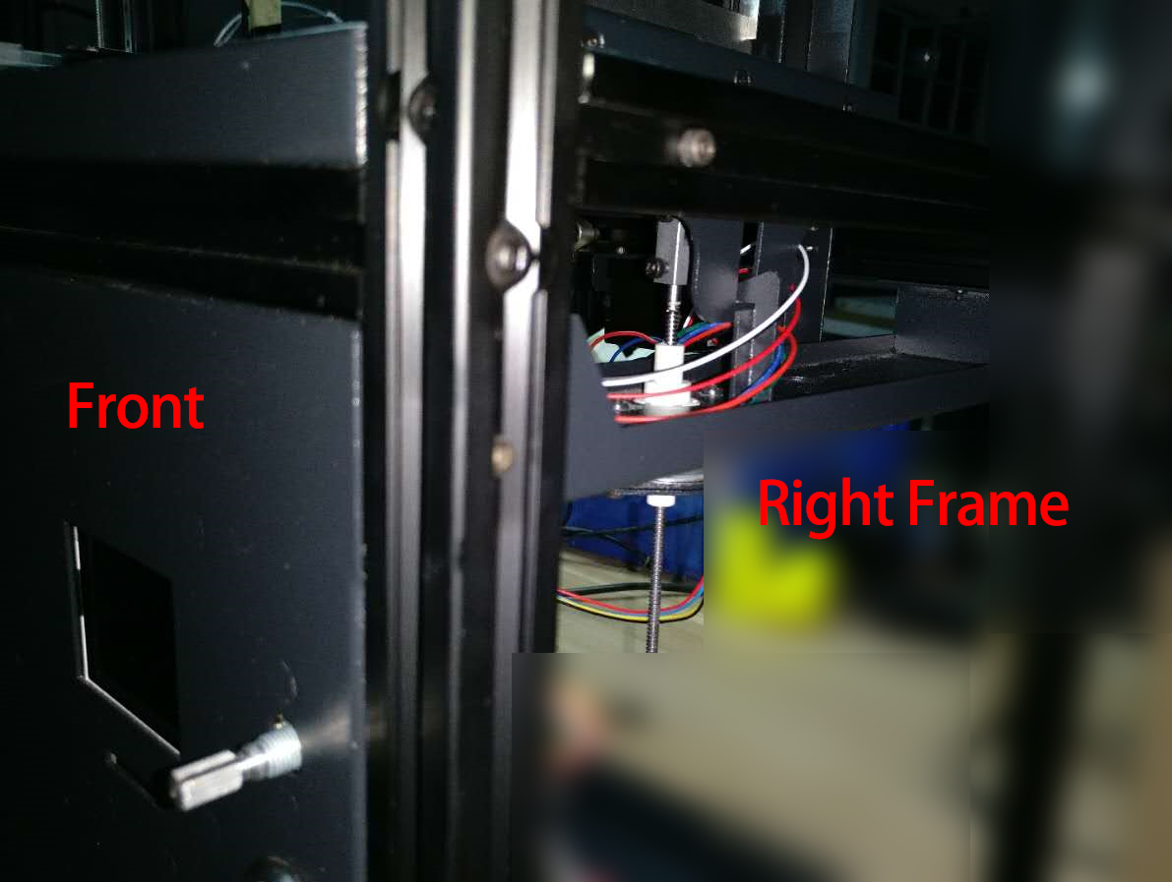
Secure Metal Piece with Hook. At the circle spot with CH M3-6 screws. With the Hook facing inside of the machine, pointing toward to the Rise Motor
Installation tip video here
Metal Hook
Riser Motor

Slide 36


Find the Bottom piece, it has several screw holes on it and one very pronounced screw hole that rise up. The pronounced screw hole should be closest to the Front Frame. Ues 8 CH M3-20 screws 2 on each side to secure on 4 sides
Installer note:
put the screws for front and back in first. If left and right 3 bars were not perfectly aligned, you may need to loosen their screws and align them to the bottom plate (by inserting the screws for the plate), then tighten the bar bolts down. None of the screws should require much force to start - if they do, it means something isn't aligned.

Slide 37


Here is the location of Bottom with respect to Moai

Slide 38


Find the Front Panel. Install it on the Front frame with 6 CH M3-20 screws. 2 each on Left/Right side. 1 each on Top/Bottom
if you insert the top (center) screw first it will hold the panel snugly against the top, and then the left and right screws will be easier to align.

Slide 39


Here is the location of Front Panel with respect to Moai

Slide 40


Now let’s organize the PM Motor cables and Endstop Sensor Cables as below (RS)

Slide 41


Find the Platform Cover, use 2 CH M3-6 to secure to Z-Axis Use 4 CH M3-20 to secure to Left and Right frame, 2 on each side. (Do not over tighten these 4 screws, when the screw

Slide 42

This is also a good time to make sure the Platform is centered and not rubbing against Platform Cover. You can adjust the Platform by loosing the screws on the Silver colored brackets on each end of the metal bar.

Slide 43


Here is the location of Platform Cover with respect to Moai

Slide 44
Electronics
Instruction starts next page.
You can use Video Tutorial Part6 to help

Slide 45



Now install Galvo Driver on the bottom panel. Secure with BH M4-6 Near the Right frame side Each Galvo Driver is designed for a specific Galvo. Look for the label on the Galvo Power port for indication. This is a common area where user make mistake Example: HT-Yxxxx is for Y-Galvo and vice versa
the boards are the same on the front, and the assemblies have a X or Y label on the back.
X-Galvo
Y-Galvo
Right Frame

Slide 46


Here is the location of Galvo Driver with respect to Moai
X Driver Galvo
Y Driver Galvo

Slide 47


Lay the system down with Front Panel facing downward Install the Main Board use CH M3-5 screws to tighten them. Make sure you remove the protective screen film before installing the board. here is a bigger picture of how all boards are next to each other. Top of picture is the riser and z-axis motor: https://drive.google.com/open?id=0Bzke6lBHG_z5dm5RdDdJTHRRMDQ

Slide 48


Here is the location of Main Board with respect to Moai

Slide 49



Install the SD card reader with an included metal plate. Secure with 4 CH M3-5 screws. The plug the SD reader with the plat on the main board and secure the plate with 2 CH M3-5 screws

Slide 50



Secure the Power Board (lower right picture). Both using CH M3-5 screws here is a bigger picture of how all boards are next to each other. Top of picture is the Riser and Z-Axis motor: https://drive.google.com/open?id=0Bzke6lBHG_z5dm5RdDdJTHRRMDQ (Reshoot)
Top of Front Panel
Bottom of Front Panel

Slide 51


Here is the location of Power Board with respect to Moai

Slide 52


Secure the Power Board (lower left picture) and knob control (lower right). Both using CH M3-5 screws here is a bigger picture of how all boards are next to each other. Top of picture is the riser and z-axis motor: https://drive.google.com/open?id=0Bzke6lBHG_z5dm5RdDdJTHRRMDQ (Reshoot)
For electronic installtion, you can view video: https://www.youtube.com/watch?v=i9Qfwfzho98

Slide 53



Locate the galvo/laser fixture packaging and carefully remove it. The unlock the metal protector on the top after it is installed on the main board

Slide 54

Remove the metal protective cover using M3 screws.

Slide 55


Here is the location of Power Board with respect to Moai

Slide 56


First connect the Galvo Power Cables to the X/Y Galvos on the Fixture and then
install Laser / Galvo set on the bottom panel. Use 4 CH M3-6 to Secure the Fixture DO NOT TOUCH GALVO MIRROR or LASER FRONT ELEMENT

Slide 57
Cabling: All cables have labels on them The connection can be made by looking at below pics and match the port name to the cable label
Diagram: needs update board picture reference: https://drive.google.com/open?id=0Bzke6lBHG_z5VWd2ZG1yQ182WE0 Driver picture reference: https://drive.google.com/open?id=0Bzke6lBHG_z5a1Ntek5tMUozNmM Laser/Galvo picture reference: https://drive.google.com/open?id=0Bzke6lBHG_z5V1RuM2dsNDFUYmM

Slide 58

Connection Diagram click here to download

Slide 59

Common Cable Mistake:
The Endstop Sensor cable port shown is a frequent cable user missed. If user forgot to plug this cable. The power up sequence may damage sensor. Please double check Endstop Sensor and make sure it is correctly installed to the right port.

Slide 60
Door,Panels, Misc
Instruction starts next page.
You can use Video Tutorial Part7 to help

Slide 61


Find and install Front Panel, Use 6 BH M3-16 screws to secure
it is probably easiest if you install the top screws first, then the cover will hang from them - and the rest of the holes will be aligned

Slide 62

Here is the location of Front Door with respect to Moai

Slide 63




Install Front Door to Front Panel, Find these pieces Use 4 FH M5x12 on the Door, Use 4 FH M5x25 to secure Door on the Panel

Slide 64



For Door Lock, find the Door Lock Set as seen on the left picture
push the Lock through the hole on the Door Panel from outside in, screw the Ring in from the inside of the panel, put the Lock Arm as seen in the right picture. Then use the Screw to secure the Lock Arm

Slide 65



follow pictures to install Door Handle. Making sure that the larger hole is facing toward the floor before installing the hinge bracket. Use the CH M4x8 to secure the Door handle
This Side
Facing inside of printer
This Side
Facing inside of printer

Slide 66


Find Knob Cover Install Knob Cover to Front Panel, there should be a metal beam sticking out from the Control Unit We include both Black and Silver knob for your preference

Slide 67


Find Power Switch (See left picture) There is rubber ring and a metal ring. Remove both before installing

Slide 68


Make sure insert Power Switch with cable through the Front panel holes Put on rubber ring and then a metal ring. Secure the Power Switch from the back buy put rubber ring all the way in first and tighen the metal ring. Contact the Power Switch Cable to the highlighted port

Slide 69



Install Back panel for Back frame, you can Identify it by the hole Install Power Cable by pull a part of cable thru Back Panel’s hole. Use 6 BH M3-16 screws to secure**
it is probably easiest if you install the top screws first, then the cover will hang from them - and the rest of the holes will be aligned.

Slide 70


Here is the location of Back Panel with respect to Moai

Slide 71


Install Back panel for Back frame, you can Identify it by the whole Install Power Cable by Use 6 BH M3-16 screws to secure

Slide 72


Before you close it up, please check out how to manage all the cables so it doesn’t block off laser or caught by motor: here is the document: https://drive.google.com/open?id=10Hs4L5ChrQcMRv-hTj1OjxoXU1Nje65PGSYR9zzE0nU

Slide 73


Find Protection Acrylic seen here. Install it to the galvo using silicone based gel (don’t use cyanoacrylate),just small amount and it will secure it. Tape would work too. Make sure you remove both sides’ protective film before proceeding

Slide 74



We recommend you do this last step ONLY AFTER YOU PRINTER PASS ALL the CALIBRATION and TEST PRINT because panels may hinder leveling. USE Protection Glass when running test with panels off! You can now go back to user guide to follow calibration step. Install Left, Right and the Top. Use 6 BH M3-16 screws to secure each panel on the Right and Left. 4 for the Top Panel. Make sure the slant on the panel is facing outward.

